Slide 1
SNACK SQUAD:A Customizable Snack Ordering and Delivery App
Akilan B
710422243057

Slide 2
DESCRIPTION
Customizable Snack Packs: Create your own snack packs by selecting from a diverse range of snacks.
Personalized Recommendations: AI-driven suggestions based on past orders and preferences.
Subscription Plants: Flexible plans for regular snack deliveries,customizable in frequency and contents.
Real-Time Tracking: Track your order from preparation to delivery.
Dietary Filters: Options for gluten-free, vegan, keto and more.
Exclusive Deals and Rewards: Enjoy discounts, loyalty rewards,and special offers.
User Reviews and Ratings: Read reviews and ratings from other users.
Secure Payments: Multiple payment options with secure transactions.
Intuitive Interface: User-friendly design for easy browsing and ordering.
Quick Reordering: Easily reorder your favorite snacks.
Target Audience: Ideal for busy professionals, students, health-conscious individuals and snack lovers.
Technology Stack: Built with React Native, Node.js, Express, MongoDB,and AI integration.

Slide 3
Main Activity.java:
package com.example.cricketscorerecorder;
import androidx.appcompat.app.AppCompatActivity;
import android.content.Intent;
import android.os.Bundle;
import android.view.View;
import android.widget.Button;
import android.widget.EditText;
public class MainActivity extends AppCompatActivity {
Button one, two, three, four, six, wide, no, out;
Button convert;
EditText resultconvert;
int runs = 0, wickets=0, balls=0;
double overs=0.0;
EditText run, wicket, over;
Button Extra;
EditText exruns;
@Override
protected void onCreate(Bundle savedInstanceState) {
super.onCreate(savedInstanceState);
setContentView(R.layout.activity_main);
run = (EditText)findViewById(R.id.runs);
wicket = (EditText) findViewById(R.id.out);

Slide 4
over = (EditText)findViewById(R.id.over);
one = (Button)findViewById(R.id.one);
two = (Button)findViewById(R.id.two);
three = (Button)findViewById(R.id.three);
four = (Button)findViewById(R.id.four);
six = (Button)findViewById(R.id.six);
wide = (Button)findViewById(R.id.wide);
no = (Button)findViewById(R.id.no);
out = (Button)findViewById(R.id.button2);
convert = (Button)findViewById(R.id.convert);
resultconvert = (EditText)findViewById(R.id.covertedresult);
Extra = (Button)findViewById(R.id.button3);
exruns = (EditText)findViewById(R.id.extra);
one.setOnClickListener(new View.OnClickListener() {
@Override
public void onClick(View v) {
runs = runs+1;
run.setText(Integer.toString(runs));
balls=balls+1;
over.setText(Integer.toString(balls));
}
});
two.setOnClickListener(new View.OnClickListener() {
@Override

Slide 5
public void onClick(View v) {
runs = runs+2;
run.setText(Integer.toString(runs));
balls = balls+1;
over.setText(Integer.toString(balls));
}
});
three.setOnClickListener(new View.OnClickListener() {
@Override
public void onClick(View v) {
runs = runs+3;
run.setText(Integer.toString(runs));
balls = balls+1;
over.setText(Integer.toString(balls));
}
});
four.setOnClickListener(new View.OnClickListener() {
@Override
public void onClick(View v) {
runs = runs+4;
run.setText(Integer.toString(runs));
balls = balls+1;
over.setText(Integer.toString(balls));
}

Slide 6
});
six.setOnClickListener(new View.OnClickListener() {
@Override
public void onClick(View v) {
runs = runs+6;
run.setText(Integer.toString(runs));
balls = balls+1;
over.setText(Integer.toString(balls));
}
});
wide.setOnClickListener(new View.OnClickListener() {
@Override
public void onClick(View v) {
runs = runs+1;
run.setText(Integer.toString(runs));
}
});
no.setOnClickListener(new View.OnClickListener() {
@Override
public void onClick(View v) {
runs = runs+1;
run.setText(Integer.toString(runs));
}
});

Slide 7
out.setOnClickListener(new View.OnClickListener() {
@Override
public void onClick(View v) {
wickets = wickets+1;
wicket.setText(Integer.toString(wickets));
balls = balls+1;
over.setText(Integer.toString(balls));
}
});
convert.setOnClickListener(new View.OnClickListener() {
@Override
public void onClick(View v) {
String no=over.getText().toString();
int a = Integer.parseInt(no);
int rem = a%6;
int quotient = a/6;
resultconvert.setText((quotient+"."+rem));
}
});
Extra.setOnClickListener(new View.OnClickListener() {
@Override

Slide 8
public void onClick(View v) {
String no = exruns.getText().toString();
int zero =0;
int a = Integer.parseInt(no);
runs = runs+a;
run.setText(Integer.toString(runs));
exruns.setText(Integer.toString(zero));
}
});
}
}
Activity_main.xml:
<?xml version="1.0" encoding="utf-8"?>
<androidx.constraintlayout.widget.ConstraintLayout xmlns:android="http://schemas.android.com/apk/res/android"
xmlns:app="http://schemas.android.com/apk/res-auto"
xmlns:tools="http://schemas.android.com/tools"
android:id="@+id/cricket“
android:layout_width="match_parent"
android:layout_height="match_parent"
android:background="@color/AliceBlue"
tools:context=".MainActivity">

Slide 9
<TextView
android:id="@+id/textView2"
android:layout_width="wrap_content"
android:layout_height="wrap_content"
android:layout_marginStart="48dp"
android:layout_marginLeft="48dp"
android:layout_marginTop="32dp"
android:text="@string/total_runs"
android:textColor="@color/Black"
android:textSize="30sp"
app:layout_constraintStart_toStartOf="parent"
app:layout_constraintTop_toTopOf="parent" />
<Button
android:id="@+id/two"
android:layout_width="72dp"
android:layout_height="77dp"
android:layout_marginEnd="188dp"
android:background="@drawable/ic_launcher_background"
android:backgroundTint="@color/AliceBlue"
android:text="@string/_2"
android:textColor="@color/BlueViolet"
android:textSize="30sp"
app:layout_constraintBottom_toBottomOf="parent"
app:layout_constraintEnd_toEndOf="parent"

Slide 10
app:layout_constraintHorizontal_bias="1.0"
app:layout_constraintStart_toStartOf="parent"
app:layout_constraintTop_toTopOf="parent"
app:layout_constraintVertical_bias="0.391" />
<Button
android:id="@+id/six"
android:layout_width="72dp"
android:layout_height="77dp"
android:text="@string/_6"
android:textColor="@color/BlueViolet"
android:textSize="30sp"
app:layout_constraintBottom_toBottomOf="parent"
app:layout_constraintEnd_toEndOf="parent"
app:layout_constraintHorizontal_bias="0.879"
app:layout_constraintStart_toStartOf="parent"
app:layout_constraintTop_toTopOf="parent"
app:layout_constraintVertical_bias="0.553" />
<Button
android:id="@+id/no"
android:layout_width="104dp"
android:layout_height="81dp"
android:text="@string/no_ball"
android:textColor="@color/BlueViolet"
android:textSize="20sp"

Slide 11
app:layout_constraintBottom_toBottomOf="parent"
app:layout_constraintEnd_toEndOf="parent"
app:layout_constraintHorizontal_bias="0.091"
app:layout_constraintStart_toStartOf="parent"
app:layout_constraintTop_toTopOf="parent"
app:layout_constraintVertical_bias="0.703" />
<Button
android:id="@+id/wide"
android:layout_width="86dp"
android:layout_height="75dp"
android:text="@string/wide_ball"
android:textColor="@color/BlueViolet"
android:textSize="20sp"
app:layout_constraintBottom_toBottomOf="parent"
app:layout_constraintEnd_toEndOf="parent"
app:layout_constraintHorizontal_bias="0.486"
app:layout_constraintStart_toStartOf="parent"
app:layout_constraintTop_toTopOf="parent"
app:layout_constraintVertical_bias="0.696" />
<Button
android:id="@+id/three"
android:layout_width="72dp"
android:layout_height="77dp"
android:background="@drawable/ic_launcher_background"

Slide 12
android:text="@string/_3"
android:textColor="@color/BlueViolet"
android:textSize="30sp"
app:layout_constraintBottom_toBottomOf="parent"
app:layout_constraintEnd_toEndOf="parent"
app:layout_constraintHorizontal_bias="0.586"
app:layout_constraintStart_toEndOf="@+id/two"
app:layout_constraintTop_toTopOf="parent"
app:layout_constraintVertical_bias="0.391" />
<Button
android:id="@+id/one"
android:layout_width="72dp"
android:layout_height="77dp"
android:background="@drawable/ic_launcher_background"
android:backgroundTint="@color/AliceBlue"
android:text="@string/_1“
android:textColor="@color/BlueViolet"
android:textSize="30sp"
app:layout_constraintBottom_toBottomOf="parent"
app:layout_constraintEnd_toStartOf="@+id/two"
app:layout_constraintHorizontal_bias="0.349"
app:layout_constraintStart_toStartOf="parent"
app:layout_constraintTop_toTopOf="parent"

Slide 13
app:layout_constraintVertical_bias="0.391" />
<Button
android:id="@+id/four"
android:layout_width="72dp"
android:layout_height="77dp"
android:background="@drawable/ic_launcher_background"
android:text="@string/_4"
android:textColor="@color/BlueViolet"
android:textSize="30sp"
app:layout_constraintBottom_toBottomOf="parent"
app:layout_constraintEnd_toStartOf="@+id/six"
app:layout_constraintHorizontal_bias="0.157"
app:layout_constraintStart_toStartOf="parent"
app:layout_constraintTop_toTopOf="parent"
app:layout_constraintVertical_bias="0.564" />
<EditText
android:id="@+id/runs"
android:layout_width="123dp"
android:layout_height="50dp"
android:autofillHints=""
android:ems="10"
android:inputType="number"
android:text="@string/_0"
android:textColor="@color/DarkRed"

Slide 14
android:textSize="28sp"
android:textStyle="bold"
app:layout_constraintBottom_toBottomOf="parent"
app:layout_constraintEnd_toEndOf="parent"
app:layout_constraintHorizontal_bias="0.857"
app:layout_constraintStart_toStartOf="parent"
app:layout_constraintTop_toTopOf="parent"
app:layout_constraintVertical_bias="0.052" />
<EditText
android:id="@+id/out"
android:layout_width="123dp"
android:layout_height="50dp"
android:autofillHints=""
android:ems="10"
android:inputType="number"
android:text="@string/_0"
android:textColor="@color/DarkRed"
android:textSize="28sp"
android:textStyle="bold"
app:layout_constraintBottom_toBottomOf="parent"
app:layout_constraintEnd_toEndOf="parent"
app:layout_constraintHorizontal_bias="0.857"
app:layout_constraintStart_toStartOf="parent"
app:layout_constraintTop_toTopOf="parent"
app:layout_constraintVertical_bias="0.207" />

Slide 15
<TextView
android:id="@+id/textView4"
android:layout_width="157dp"
android:layout_height="68dp"
android:layout_marginTop="68dp"
android:text="@string/wickets"
android:textColor="@color/Black"
android:textSize="30sp"
app:layout_constraintEnd_toStartOf="@+id/out"
app:layout_constraintHorizontal_bias="0.533"
app:layout_constraintStart_toStartOf="parent"
app:layout_constraintTop_toBottomOf="@+id/textView2" />
<TextView
android:id="@+id/textView"
android:layout_width="139dp"
android:layout_height="43dp"
android:text="@string/balls"
android:textColor="@color/Black"
android:textSize="30sp"
app:layout_constraintBottom_toBottomOf="parent"
app:layout_constraintEnd_toEndOf="parent"
app:layout_constraintHorizontal_bias="0.897"
app:layout_constraintStart_toStartOf="parent"
app:layout_constraintTop_toTopOf="parent"

Slide 16
app:layout_constraintVertical_bias="0.85" />
<EditText
android:id="@+id/over"
android:layout_width="143dp"
android:layout_height="65dp"
android:layout_marginStart="244dp"
android:layout_marginLeft="244dp"
android:layout_marginBottom="16dp"
android:ems="10"
android:inputType="number"
android:text="@string/_0"
android:textColor="@color/DarkRed"
android:textSize="28sp"
android:textStyle="bold"
app:layout_constraintBottom_toBottomOf="parent"
app:layout_constraintStart_toStartOf="parent" />
<Button
android:id="@+id/button2"
android:layout_width="wrap_content"
android:layout_height="wrap_content"
android:text="OUT"
android:textColor="@color/BlueViolet"
android:textSize="28sp"
app:layout_constraintBottom_toBottomOf="parent"

Slide 17
app:layout_constraintEnd_toEndOf="parent"
app:layout_constraintHorizontal_bias="0.467"
app:layout_constraintStart_toStartOf="parent"
app:layout_constraintTop_toTopOf="parent"
app:layout_constraintVertical_bias="0.547" />
<Button
android:id="@+id/convert"
android:layout_width="203dp"
android:layout_height="76dp"
android:text="Convert In Overs"
android:textColor="@color/Blue"
android:textSize="20sp"
app:layout_constraintBottom_toBottomOf="parent"
app:layout_constraintEnd_toStartOf="@+id/textView"
app:layout_constraintHorizontal_bias="0.39"
app:layout_constraintStart_toStartOf="parent"
app:layout_constraintTop_toBottomOf="@+id/no"
app:layout_constraintVertical_bias="0.119" />
<EditText
android:id="@+id/covertedresult"
android:layout_width="141dp"
android:layout_height="63dp"
android:ems="10"
android:inputType="textPersonName"

Slide 18
android:text="0"
android:textColor="@color/DarkRed"
android:textSize="25sp"
app:layout_constraintBottom_toBottomOf="parent"
app:layout_constraintEnd_toStartOf="@+id/over"
app:layout_constraintHorizontal_bias="0.339"
app:layout_constraintStart_toStartOf="parent"
app:layout_constraintTop_toTopOf="parent"
app:layout_constraintVertical_bias="0.962" />
<EditText
android:id="@+id/extra"
android:layout_width="100dp"
android:layout_height="78dp"
android:ems="10"
android:inputType="textPersonName"
android:text="@string/_0"
android:textColor="@color/DarkGoldenrod"
android:textSize="15sp"
android:textStyle="bold"
app:layout_constraintBottom_toBottomOf="@+id/over"
app:layout_constraintEnd_toEndOf="parent"
app:layout_constraintHorizontal_bias="0.935"
app:layout_constraintStart_toStartOf="parent"
app:layout_constraintTop_toTopOf="parent"

Slide 19
app:layout_constraintVertical_bias="0.78" />
<Button
android:id="@+id/button3"
android:layout_width="wrap_content"
android:layout_height="wrap_content"
android:text="Extras"
android:textStyle="bold"
app:layout_constraintBottom_toBottomOf="parent"
app:layout_constraintEnd_toEndOf="parent"
app:layout_constraintHorizontal_bias="0.913"
app:layout_constraintStart_toStartOf="parent"
app:layout_constraintTop_toTopOf="parent"
app:layout_constraintVertical_bias="0.669" />
</androidx.constraintlayout.widget.ConstraintLayout>

Slide 20
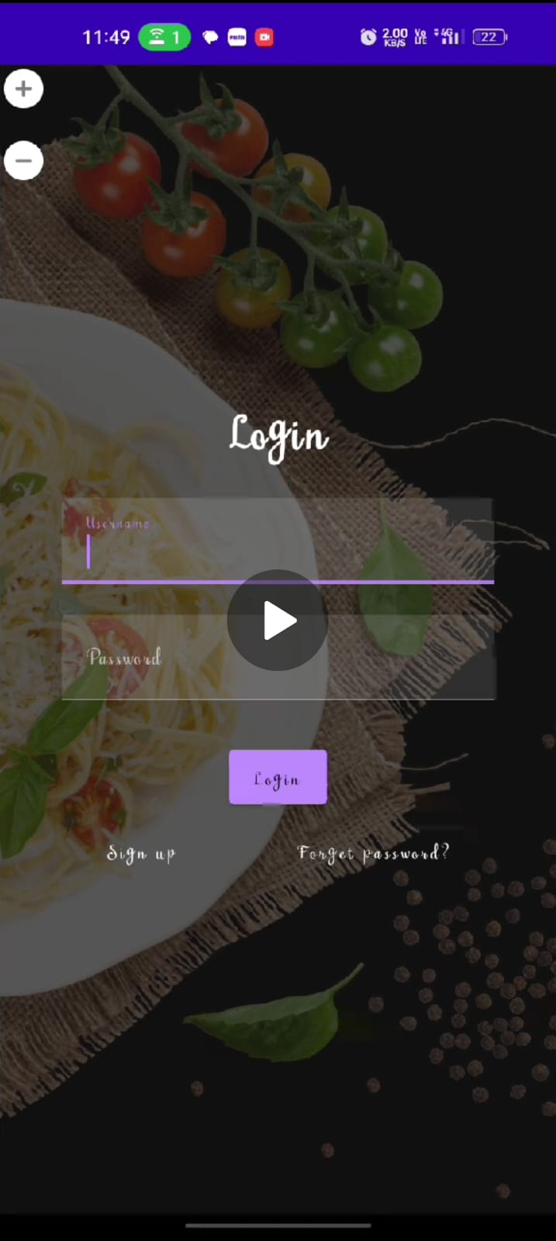
OUTPUT:

Slide 21
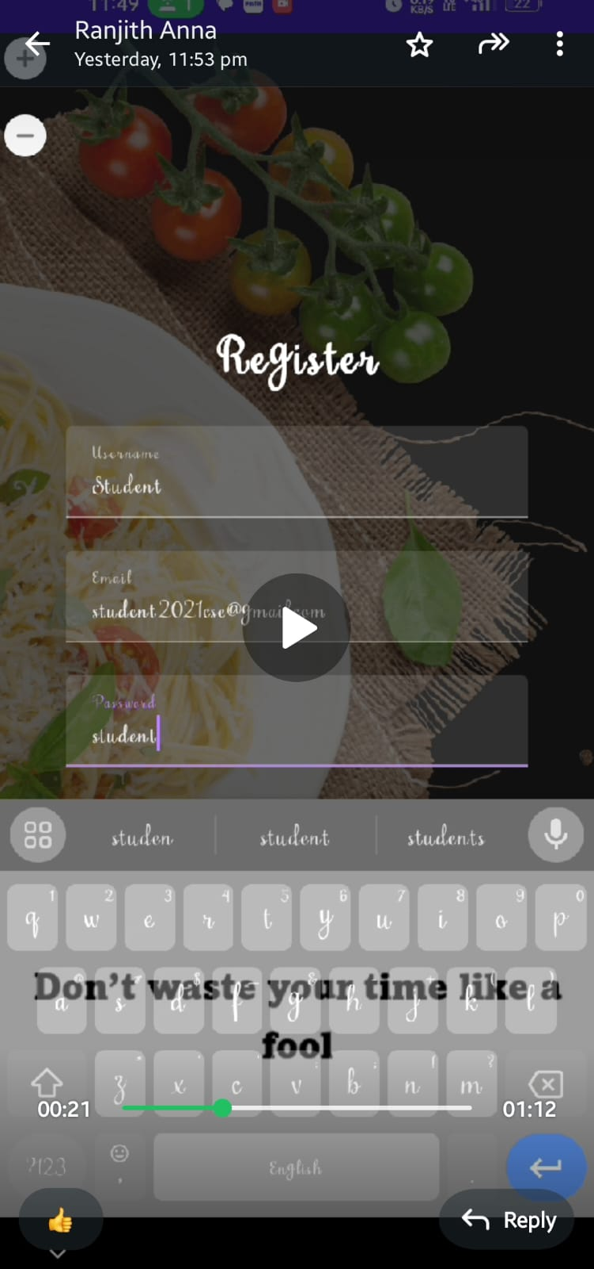

Slide 22
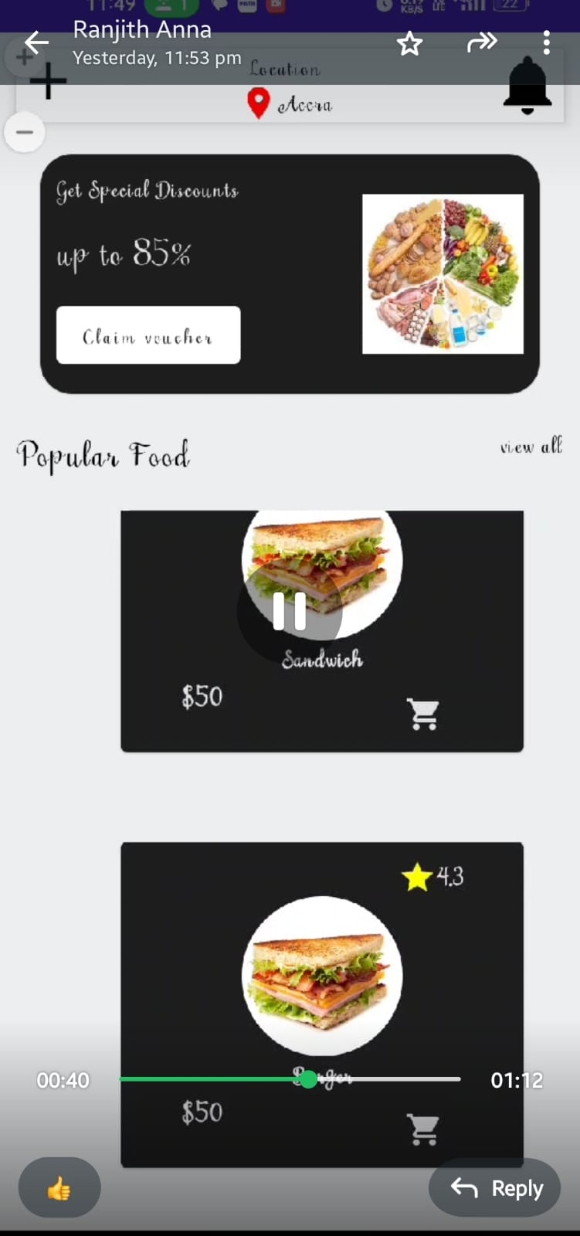

Slide 23


